Slide 1

IOTA
Energy Trading Platform
Simulation
Notes:
1. 落到交易仿真上
2. 交易平台：卖家和买家更轻松的连接
3. IOTA：类比于比特币

Slide 2

Features
Participants
Process
Demonstration
01
Features
CONTENTS
the unique features of this platform
02
Participants
the functional role of these participants
03
Process
a basic and regular trading process
04
Demonstration
operation and demonstration

Slide 3
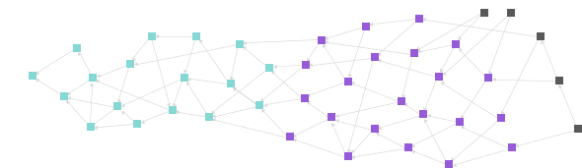
Features
01
Part One
Low Transaction Cost
Anonymity
Carbon Trade Support(Optional)

Slide 4
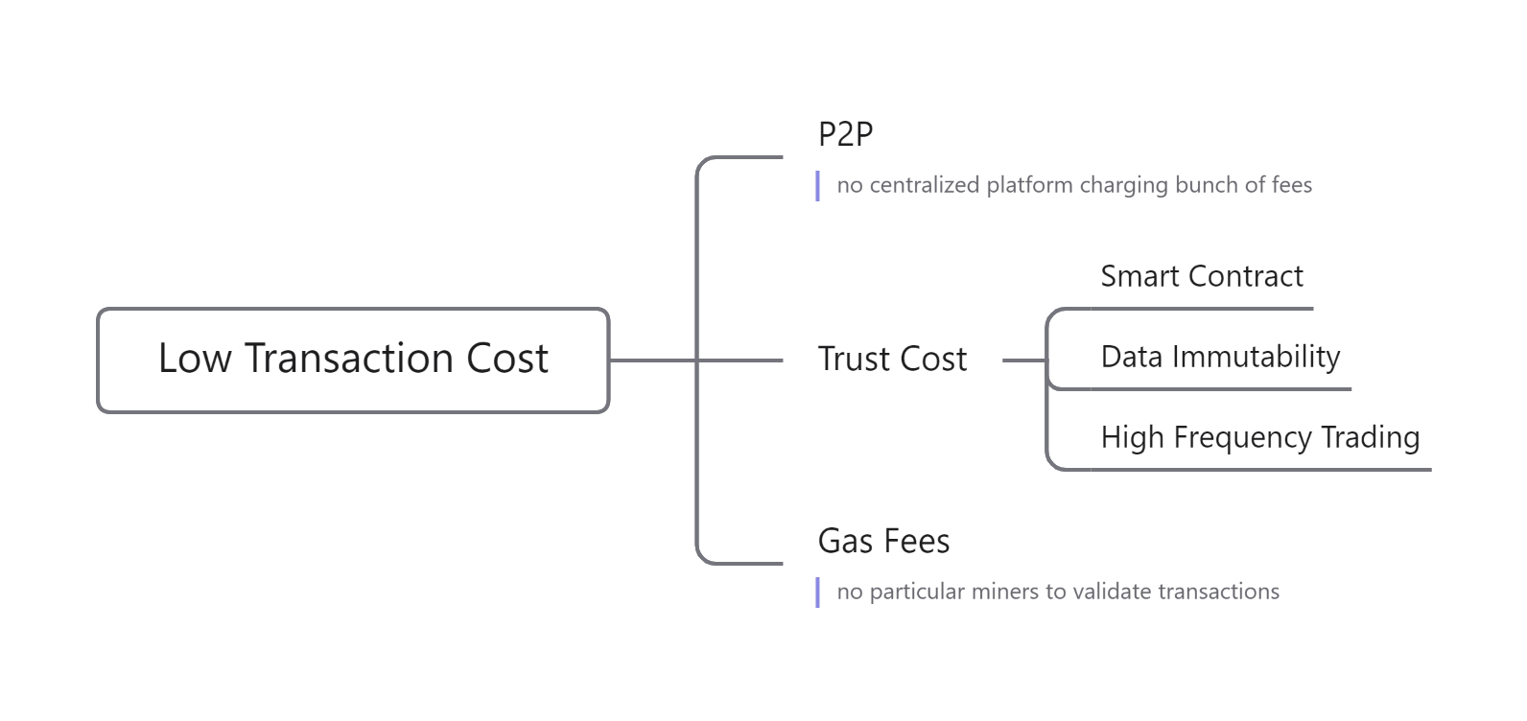
Low Transaction Cost
Features
Participants
Process
Demonstration

Slide 5
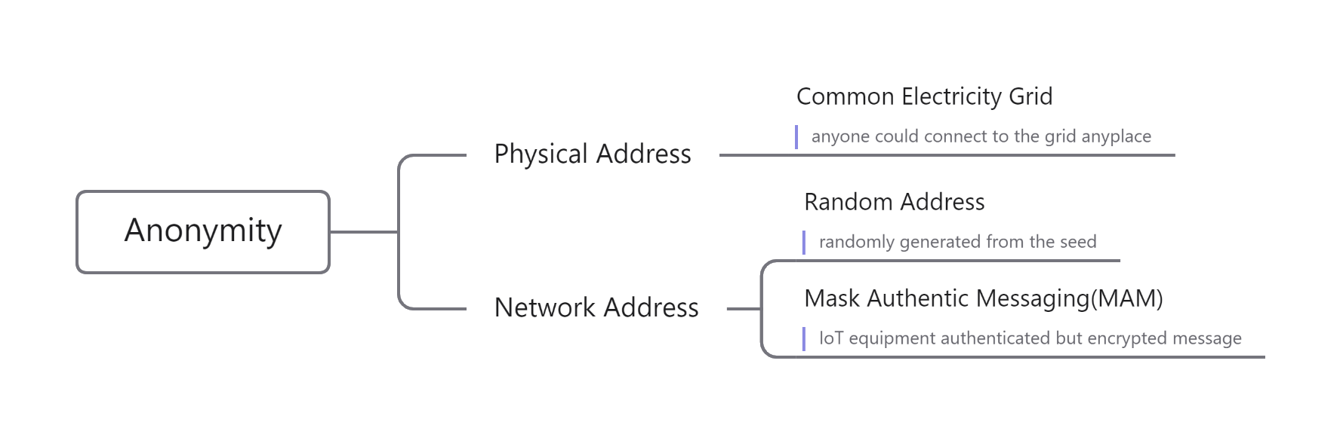
Anonymity
Features
Participants
Process
Demonstration

Slide 6
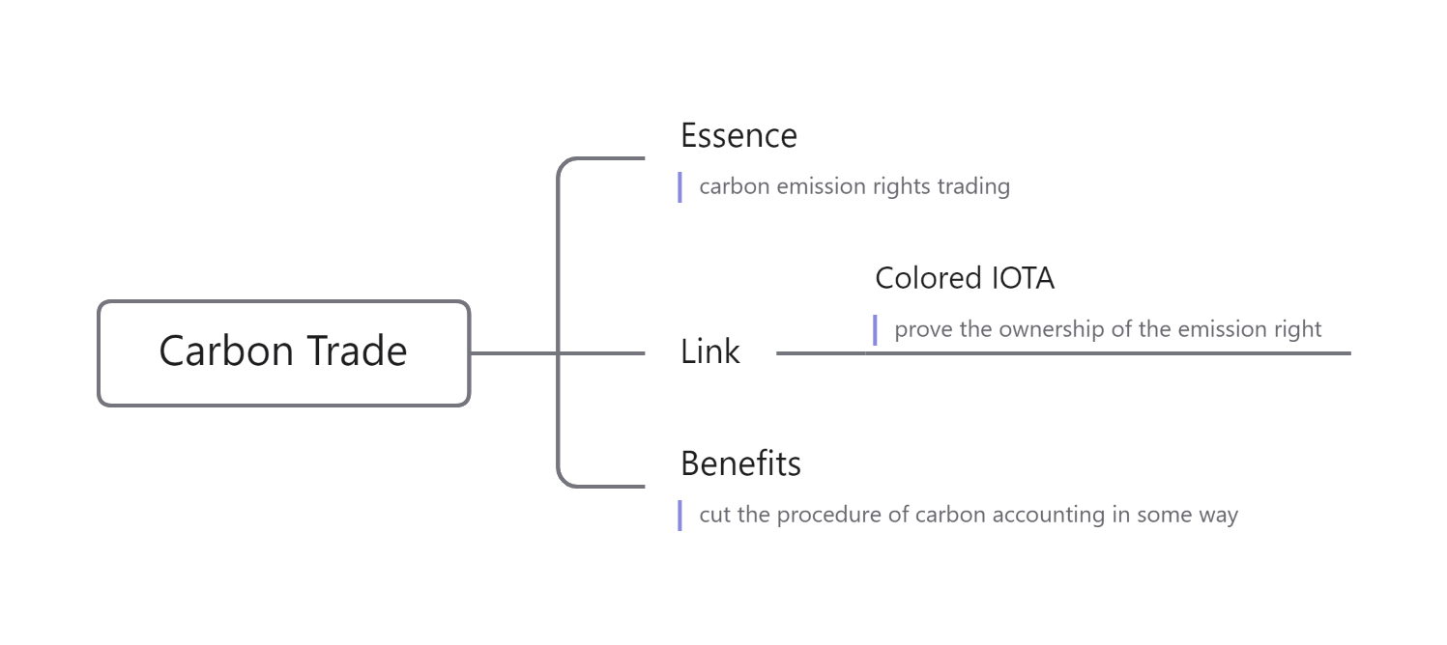
Carbon Trade Support(Optional)
Features
Participants
Process
Demonstration

Slide 7
Participants
02
Part Two
Electricity Grid
IOTA Tangle
Prosumer
Iot Equipment

Slide 8
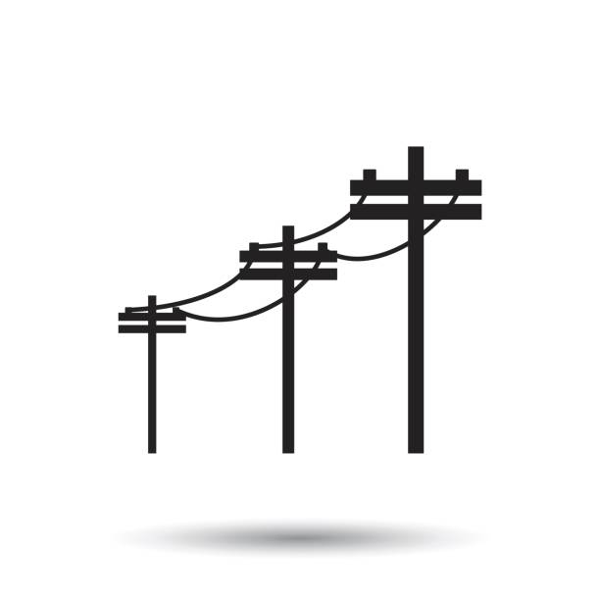
Electricity Grid
Features
Participants
Process
Demonstration
Function
a power transmission carrier
Features
1. any qualified individuals can get connected
2. electricity always flows in the grid
3. electricity production and consumption get balanced all the time

Slide 9
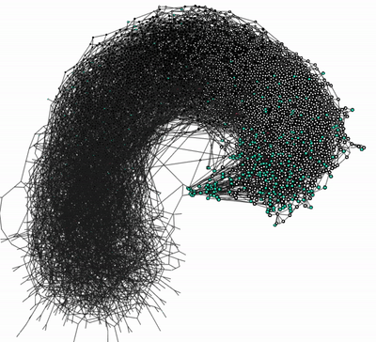
IOTA Tangle
Features
Participants
Process
Demonstration
Function
1. a public ledger
2. a communication platform
3. a value exchange platform
Features
1. data transfer is immutable
2. it is highly scalable
3. it is quantum resistant
4. there are no transaction fees

Slide 10
IOTA Tangle
Features
Participants
Process
Demonstration
Basic Conception
1. Tangle:
an innovative type of distributed ledger technology
2. Node：
a necessary tool to interact with Tangle
3. Transaction：
an information transmission media
4. Address：
the start-point and end-point of a transaction

Slide 11

Prosumer
Features
Participants
Process
Demonstration
Function
1. a seller/buyer
2. a message publisher/subscriber
3. an IOTA transactions terminal
4. an IOT adapter
Features
1. anonymous communication
2. deal closed guarantee
3. the only place IOTA stored

Slide 12

Iot Equipment
Features
Participants
Process
Demonstration
Function
1. an electricity flow state monitor
2. a message communicator
3. an electricity switch
Features
1. real time data feedback
2. informative password controled gate
3. no IOTA flow trace
4. easy to verify
5. (real time carbon accounting)

Slide 13
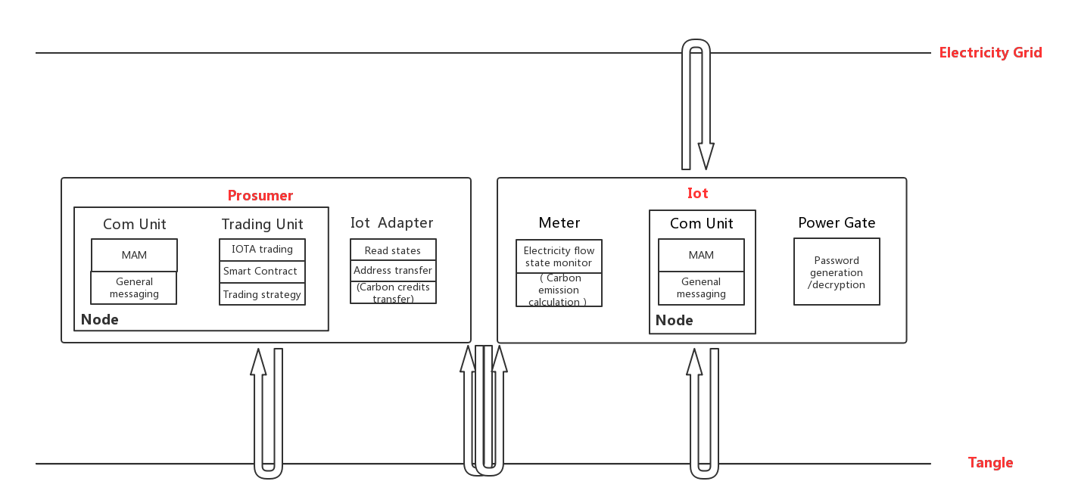
Structure Overview
Features
Participants
Process
Demonstration

Slide 14
Process
03
Part Three
Registration And Initialization
Energy Production And Consumption
Supply-Demand Matching
Power For IOTA

Slide 15
Link
Process Flow
Features
Participants
Process
Demonstration
Notes:
1. 介绍一下这个图的构成

Slide 16
Demonstration
04
Part Four
Operation Video

Slide 17
Link
Operation Video
Features
Participants
Process
Demonstration

Slide 18
Unfinished Work
Trading Strategies Design & Price Adjustment
Production & Consumption Curve Design
Multi Prosumer Engaged
Specific Electricity Balance Method
Smart Contract & MAM Implemention
Optimization Algorithm

